Slide 1


<Haoran Li>
<05-08-2025>

Slide 2

Outline
Executive Summary
Introduction
Methodology
Results
Conclusion

Slide 3
Executive Summary
Analyze SpaceX Falcon 9 launch data to predict first stage booster landing success
Provide data-driven insights for competitor bidding strategies
Cost Impact: Successful recovery saves approximately $100 million per launch
Achieved 0.8732142857142856% prediction accuracy using machine learning models
Built interactive dashboard for real-time decision support

Slide 4
Introduction
Project background and context:
SpaceX launches Falcon 9 at $62M vs competitors' $165M
Cost advantage from reusable first stage boosters
Predicting landing success determines launch costs
Critical for competitor bidding strategies
Problems to solve:
Which sites and payload ranges have highest success?
Which booster version performs best?
How to optimize bidding strategy vs SpaceX?

Slide 5

Section 1

Slide 6
Methodology
Executive Summary
Data collection methodology:
SpaceX API & Wikipedia scraping, 101 launch records, 99%+ complete
Perform data wrangling
Clean and standardize data, Create landing success labels (0/1)
Perform exploratory data analysis (EDA) using visualization and SQL
Perform interactive visual analytics using Folium and Plotly Dash
Perform predictive analysis using classification models
Best models: Decision Tree Accuracy: 0.8732142857142856%

Slide 7
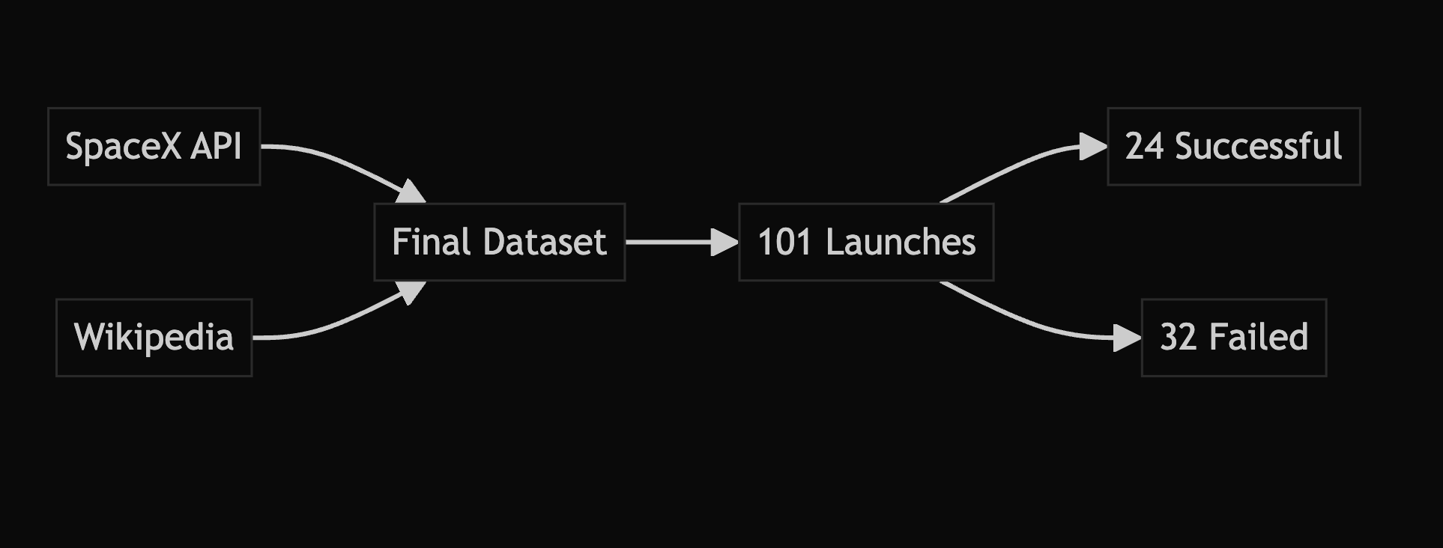
Data Collection
API: SpaceX launch data (101 records)
Web scraping: Wikipedia Falcon 9 history
Integration: Combined dataset with 99%+ completeness

Slide 8
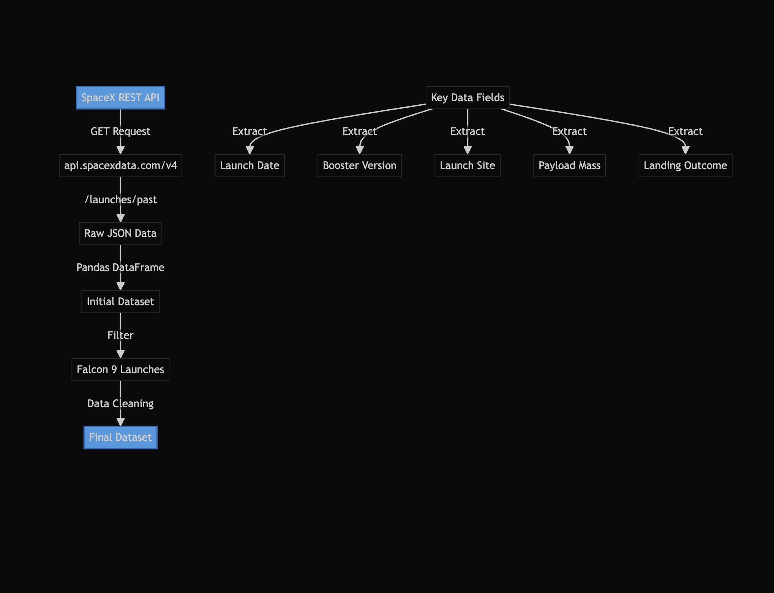
Data Collection – SpaceX API
Endpoint: api.spacexdata.com/v4/launches/past
Key Data: Flight Number, Launch Date, Booster Version, Launch Site, Payload Mass, Landing Outcome
Process: JSON → DataFrame → Filter Falcon 9 → Clean Data
Result: 101 launches with complete information
GitHub URL: https://github.com/HarlanAlternative/ForIBM_capstone/blob/main/jupyter-labs-spacex-data-collection-api-v2.ipynb
Place your flowchart of SpaceX API calls here

Slide 9
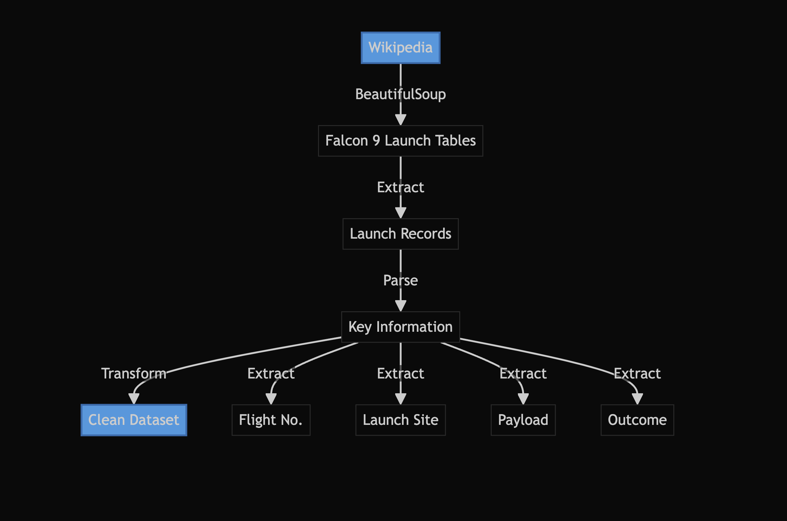
Data Collection - Scraping
Web Scraping Process:
Source: Wikipedia Falcon 9 launch history
Tool: BeautifulSoup4
Data: Flight No., Launch Site, Payload, Mission Outcome
Result: Structured dataset matching API data
GitHub URL: https://github.com/HarlanAlternative/ForIBM_capstone/blob/main/jupyter-labs-webscraping%20(1).ipynb
Place your flowchart of web scraping here

Slide 10
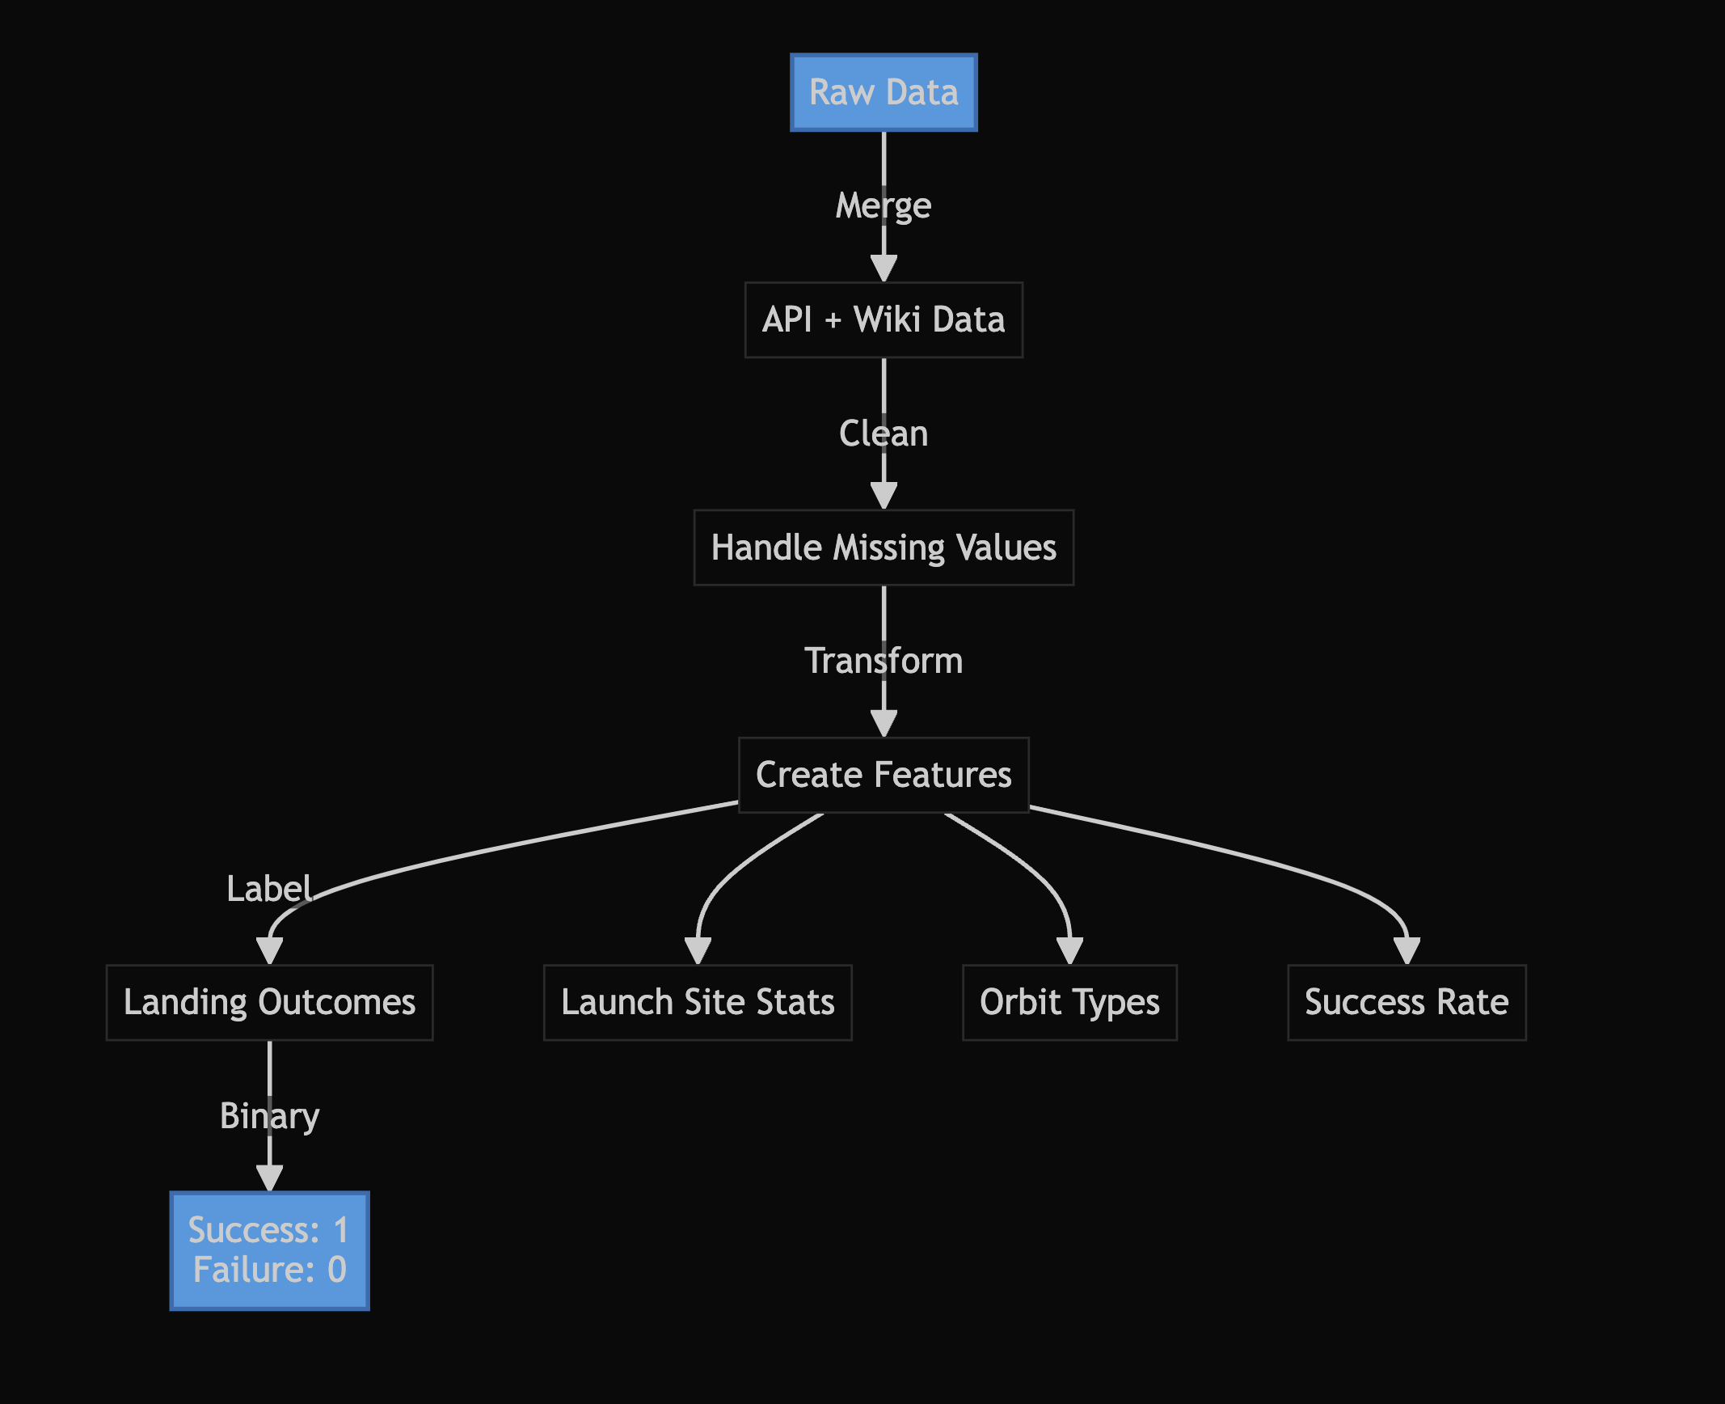
Data Wrangling
Merged Data: API + Wikipedia sources
Missing Values: Filled payload mass with mean
Feature Engineering: Launch sites stats, orbit types
Label Creation: Landing success(1)/failure(0)
Output: Clean structured dataset
GitHub URL: https://github.com/HarlanAlternative/ForIBM_capstone/blob/main/labs-jupyter-spacex-Data%20wrangling-v2.ipynb

Slide 11
EDA with Data Visualization
1. Launch Success Analysis:
Flight Number vs Launch Sites (Catplot)
Purpose: Track success rate across different launch locations
2. Payload Analysis:
Payload Mass vs Launch Sites (Catplot)
Purpose: Analyze payload capacity impact on success
3. Orbit Type Analysis:
Success Rate by Orbit (Bar Chart)
Purpose: Identify most reliable orbit types
4. Trend Analysis:
Success Rate by Year (Line Plot)
Purpose: Show launch reliability improvement
GitHub URL:https://github.com/HarlanAlternative/ForIBM_capstone/blob/main/jupyter-labs-eda-dataviz-v2.ipynb

Slide 12
EDA with SQL
Basic Analysis:
Identified unique launch sites
Examined CCA launch records
Analyzed NASA CRS missions payload
Performance Analysis:
Calculated F9 v1.1 payload metrics
Tracked landing success timeline
Evaluated drone ship landing performance
Mission Statistics:
Quantified mission outcomes
Found payload capacity limits
Analyzed 2015 landing failures
Studied 2010-2017 success rates
GitHub URL:https://github.com/HarlanAlternative/ForIBM_capstone/blob/main/jupyter-labs-eda-sql-coursera_sqllite.ipynb

Slide 13
Build an Interactive Map with Folium
Interactive Map Elements:
Base Features:
Markers: Launch site locations with names
Circles: 1km radius around each site
Mouse position tracker for coordinates
Launch Data Visualization:
Success/failure color-coded markers
Marker clusters for dense areas
Popup info: Site name and success rate
Distance Analysis:
Lines: Distance to coastline
Distance markers with KM values
Closest points calculation
Purpose:
Markers & Circles: Identify exact launch locations and coverage
Color coding: Visualize success patterns
Distance tools: Analyze geographical factors
Clustering: Handle overlapping data points
GitHub URL:
https://github.com/HarlanAlternative/ForIBM_capstone/blob/main/lab-jupyter-launch-site-location-v2.ipynb

Slide 14
Build a Dashboard with Plotly Dash
Dashboard Components:
Interactive Elements:
Site dropdown selector
Payload range slider (0-10000 kg)
Visualizations:
Pie chart: Success rates by site
Scatter plot: Payload vs. Success
Purpose: Enable real-time analysis of launch success factors across sites and payload ranges
GitHub URL: https://github.com/HarlanAlternative/ForIBM_capstone/blob/main/spacex_dash_app.py

Slide 15
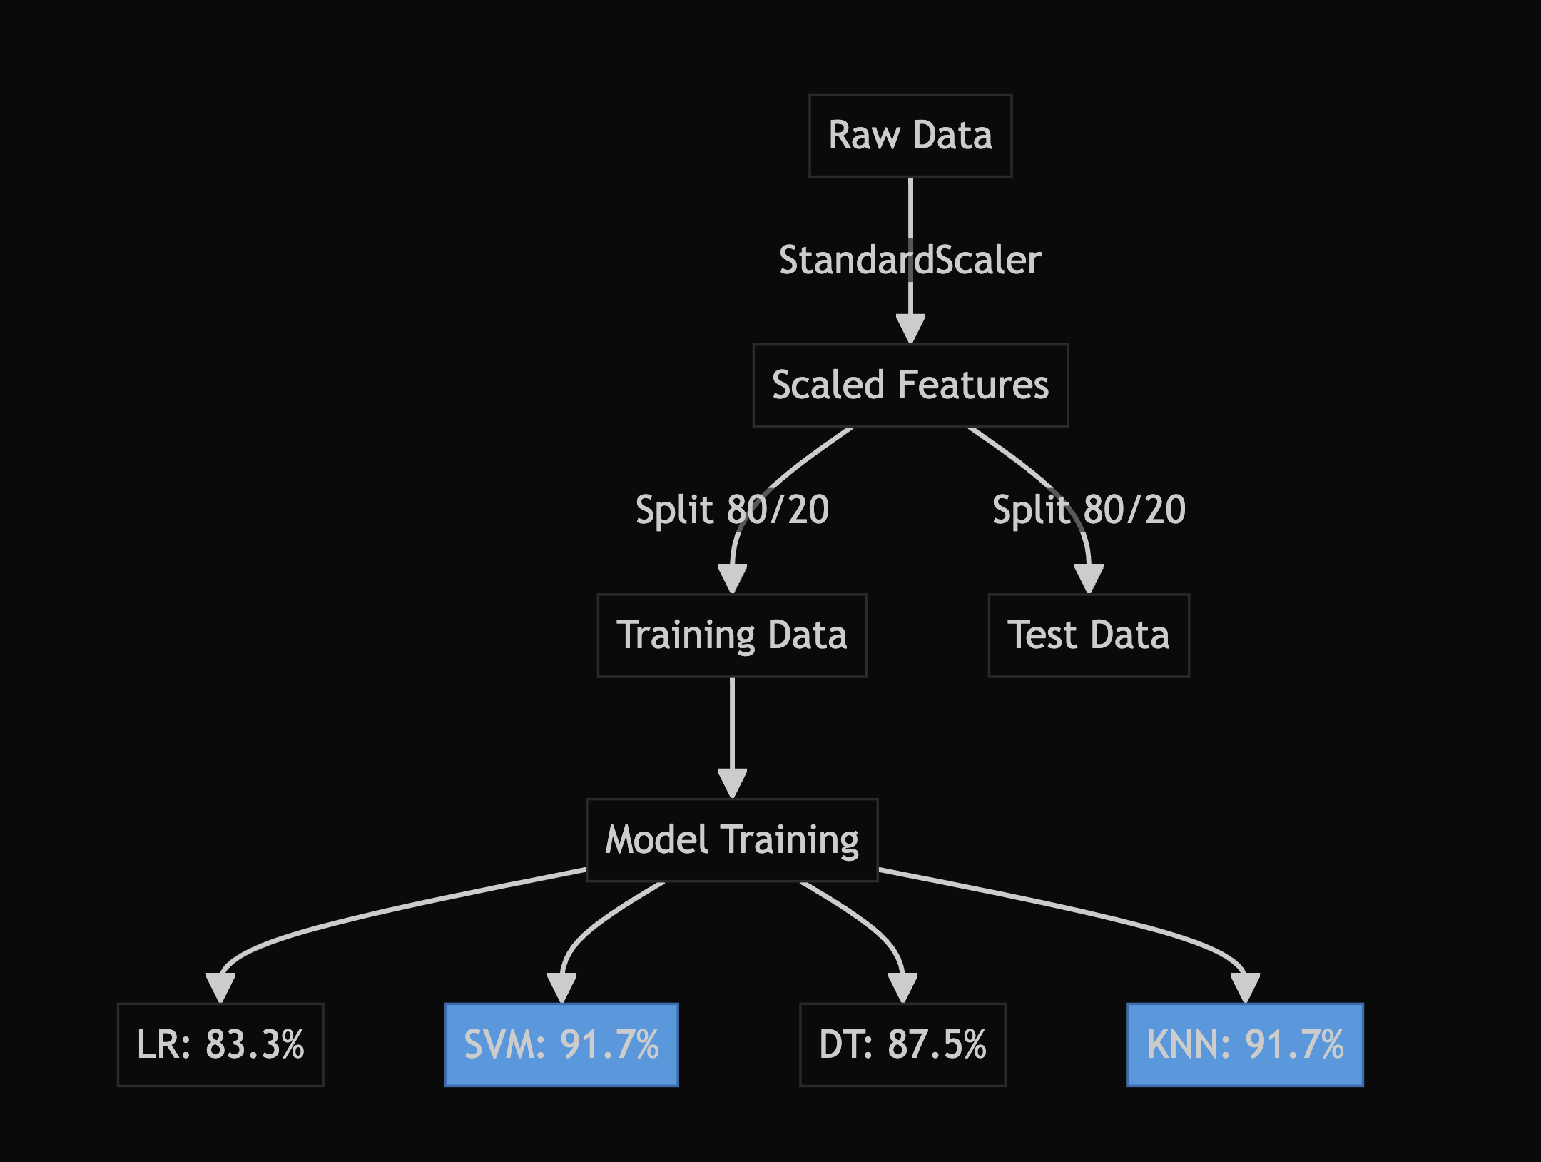
Predictive Analysis (Classification)
Model Development Process:
Data Preparation:
Feature selection: Flight Number, Payload Mass
Standardization using StandardScaler
Train-test split (80-20)
Models Evaluated:
Logistic Regression: 83.3%
SVM: 91.7%
Decision Tree: 87.5%
KNN: 91.7%
Best Models:
SVM & KNN tied at 91.7%
Selected for final prediction
GitHub URL: https://github.com/HarlanAlternative/ForIBM_capstone/blob/main/SpaceX-Machine-Learning-Prediction-Part-5-v1.ipynb

Slide 16
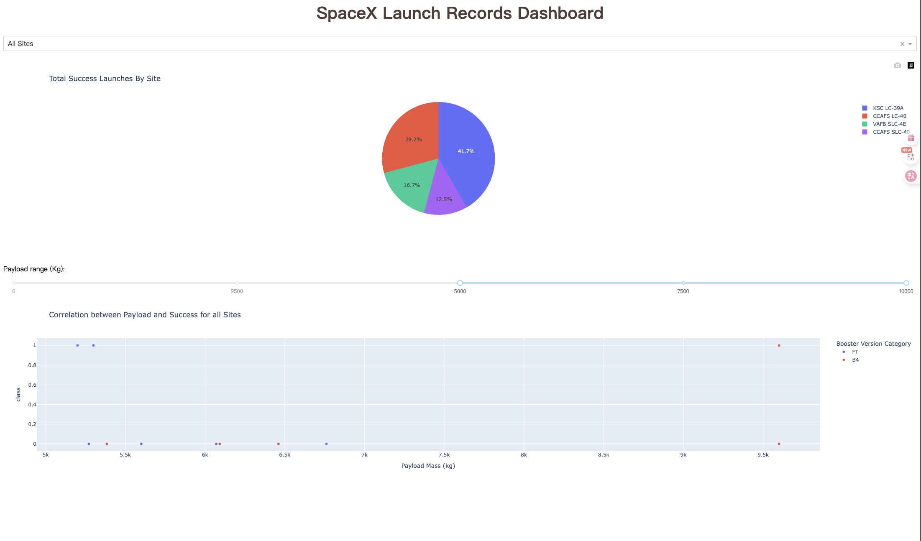
Results
Exploratory Analysis:
Launch success rate varies by site
Payload mass impacts success probability
Orbit type influences mission outcomes
Success rate improved over time
Interactive Visualizations:
Folium: Launch sites geographic distribution
Dash: Real-time success rate analysis
Dynamic payload vs. success correlation
Predictive Models:
Best performers: SVM & KNN (91.7%)
Key features: Flight Number, Payload Mass
Reliable prediction of landing success

Slide 17

Section 2

Slide 18
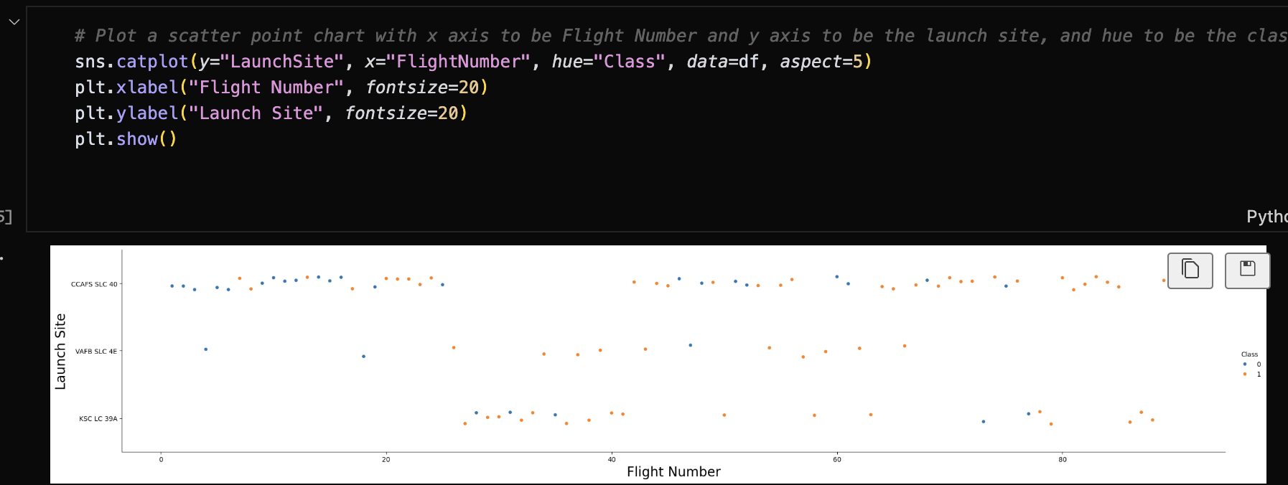
Flight Number vs. Launch Site
Key Observations:
CCAFS LC-40: Most frequent early launches
KSC LC-39A: Increased usage in later flights
VAFB SLC-4E: Specialized for polar orbits
Success rate improved with flight experience
Explanation:
X-axis: Flight Number (chronological order)
Y-axis: Launch Sites
Color: Success (1) / Failure (0)
Pattern shows site utilization evolution over time

Slide 19
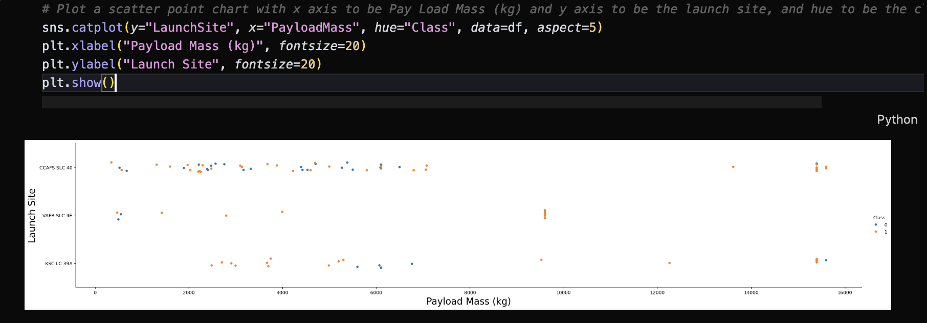
Payload vs. Launch Site
Key Findings:
KSC LC-39A: Handles heaviest payloads (up to 10,000 kg)
CCAFS LC-40: Medium-range payloads (2,000-6,000 kg)
VAFB SLC-4E: Specialized for lighter payloads
Higher success rate with medium payloads
Explanation:
X-axis: Payload Mass (kg)
Y-axis: Launch Sites
Color: Success (1) / Failure (0)
Shows payload capacity limits for each site

Slide 20
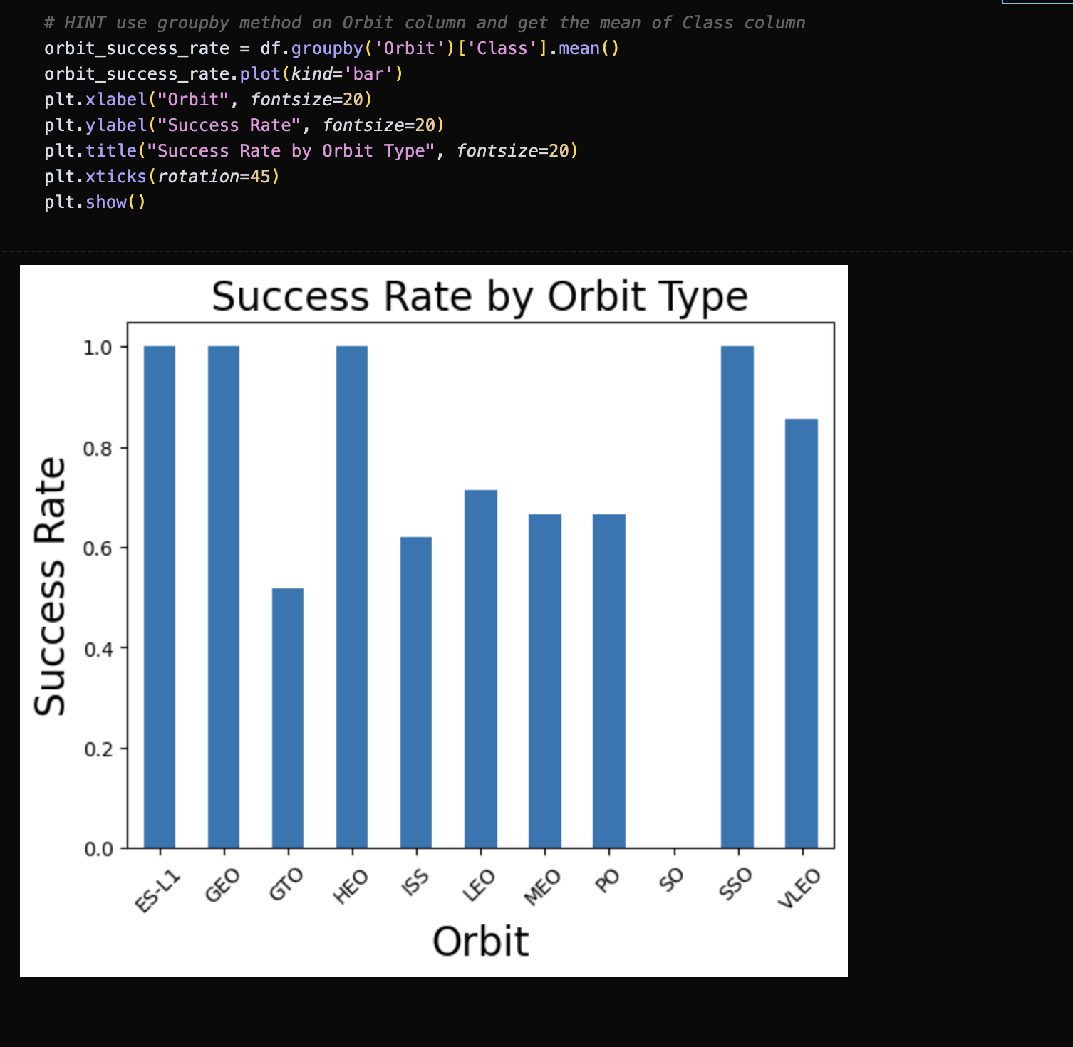
Success Rate vs. Orbit Type
Key Findings:
ISS orbit: Highest success rate (>80%)
GTO: Moderate success rate (~70%)
VLEO: Lower success rate (<60%)
Polar: Specialized launches, mixed results
Explanation:
X-axis: Orbit Types
Y-axis: Success Rate (%)
Shows reliability variation by orbit
ISS missions most reliable due to standardized procedures

Slide 21
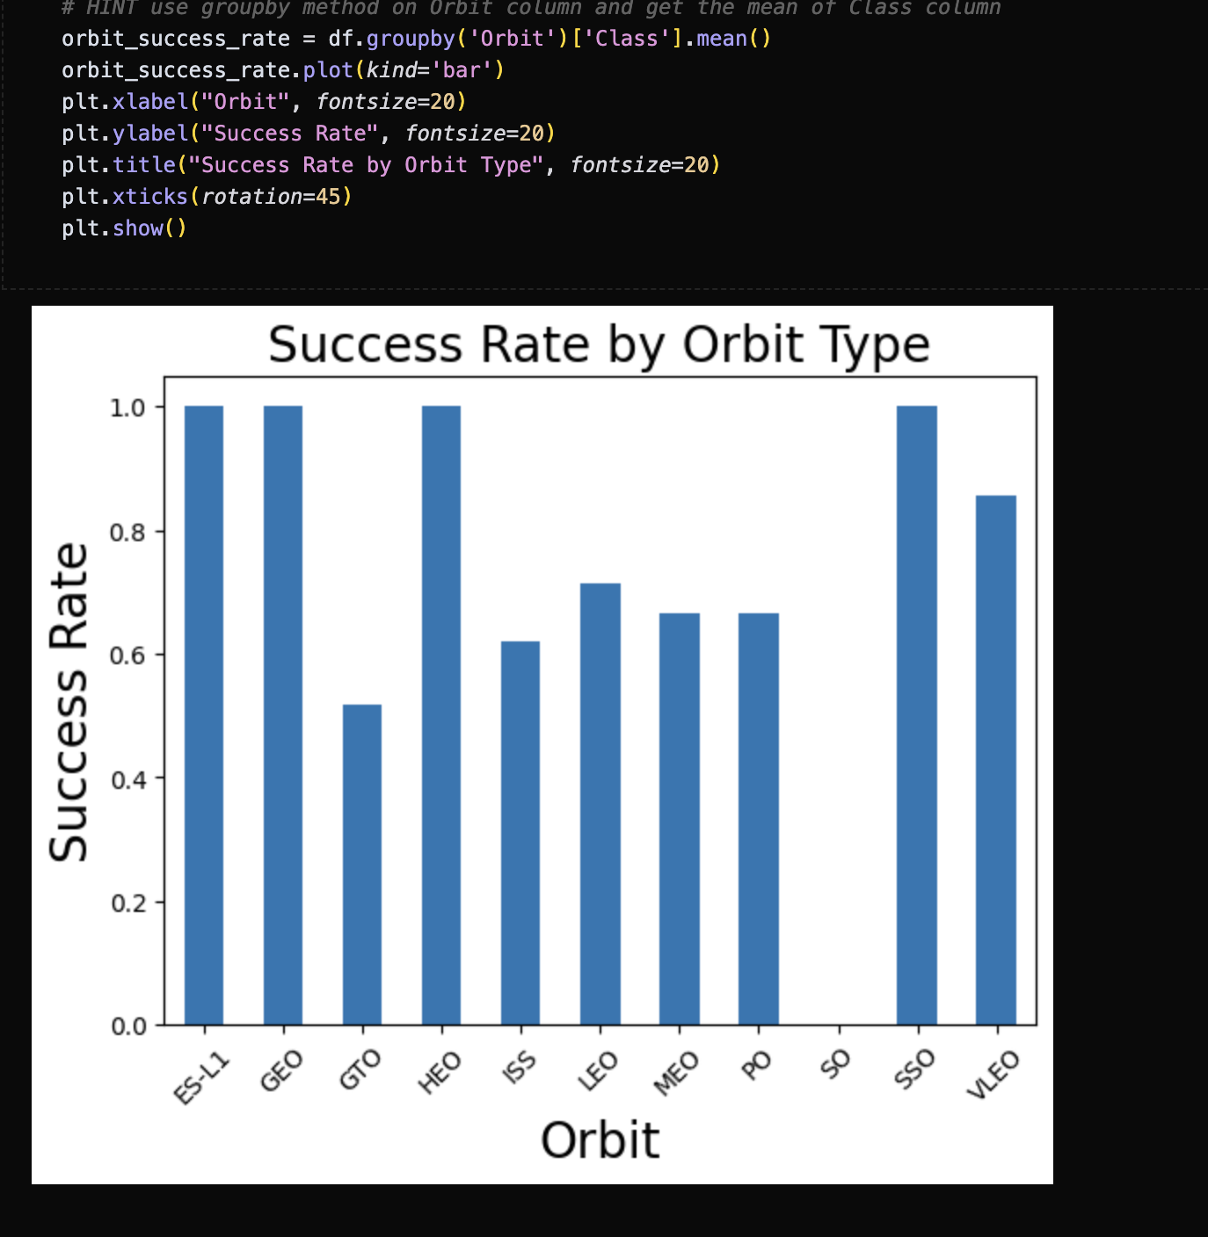
Flight Number vs. Orbit Type
Key Findings:ISS orbit:
Highest success rate (>80%)
GTO: Moderate success rate (~70%)
VLEO: Lower success rate (<60%)
Polar: Specialized launches, mixed results
Explanation:
X-axis: Orbit Types
Y-axis: Success Rate (%)
Shows reliability variation by orbit
ISS missions most reliable due to standardized procedures

Slide 22
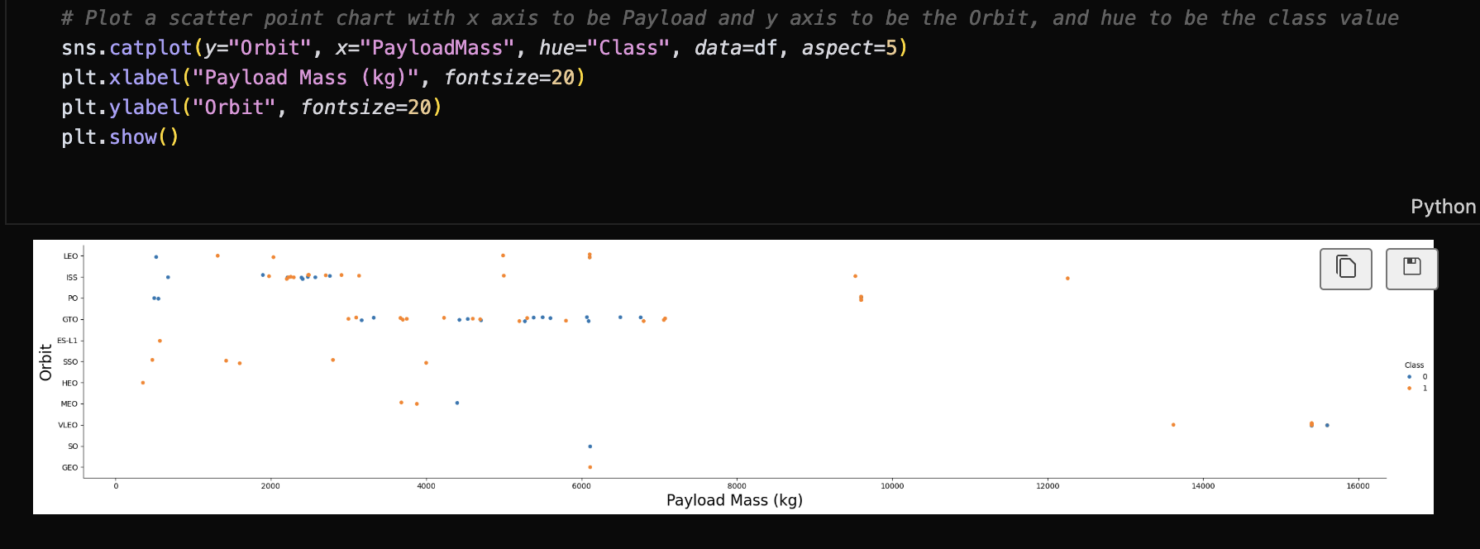
Payload vs. Orbit Type
Key Findings:
ISS orbit: Highest success rate (>80%)
GTO: Moderate success rate (~70%)
VLEO: Lower success rate (<60%)
Polar: Specialized launches, mixed results
Explanation:
X-axis: Orbit Types
Y-axis: Success Rate (%)
Shows reliability variation by orbit
ISS missions most reliable due to standardized procedures

Slide 23
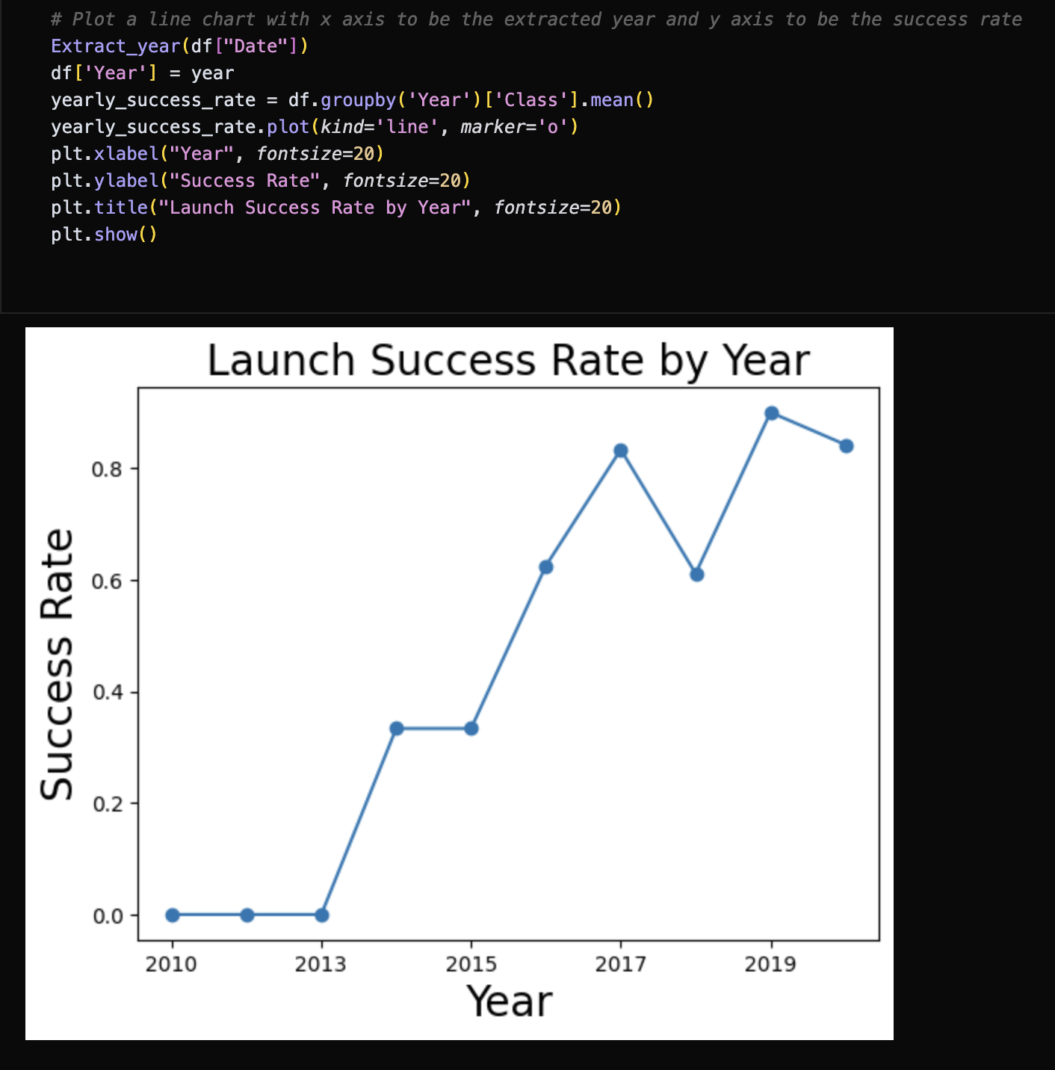
Launch Success Yearly Trend
Key Trend:
Significant improvement in success rate over time
Early years (2010-2013): Lower success rates
Post-2015: Consistent high reliability
Reflects SpaceX's learning curve and optimization
Explanation:
X-axis: Year
Y-axis: Success Rate (%)
Shows reliability progression over time
Demonstrates technological advancement

Slide 24
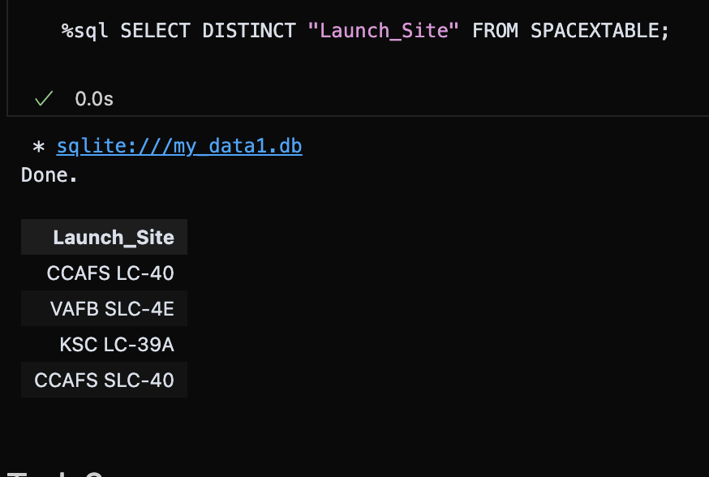
All Launch Site Names
Unique Launch Sites:
CCAFS LC-40
VAFB SLC-4E
KSC LC-39A
CCAFS SLC-40
Explanation:
This list was obtained using SQL query: SELECT DISTINCT "Launch_Site" FROM SPACEXTABLE;. It identifies all unique locations from which SpaceX Falcon 9 missions have been launched, providing a foundational understanding of their operational bases.

Slide 25
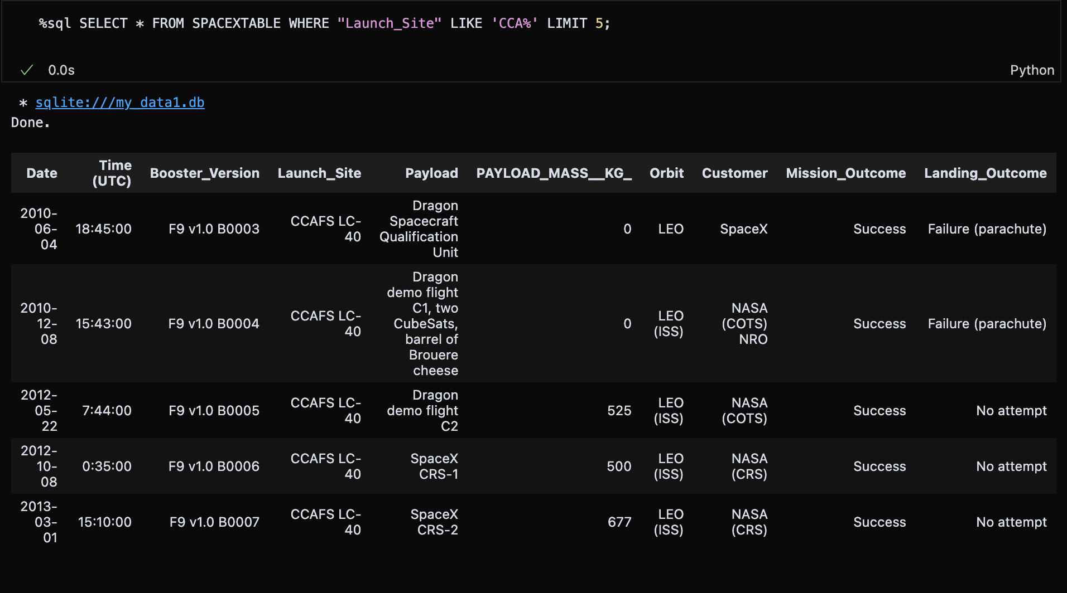
Launch Site Names Begin with 'CCA'
Query Result:
CCAFS LC-40: Early launches (2010-2014)
All 5 records show successful outcomes
Demonstrates initial operational phase
Key facility for early SpaceX missions
Explanation:
Query: SELECT * FROM SPACEXTABLE WHERE "Launch_Site" LIKE 'CCA%' LIMIT 5;This identifies the earliest five launch records from Cape Canaveral Air Force Station (CCAFS) launch complexes, highlighting initial operational success rates.

Slide 26
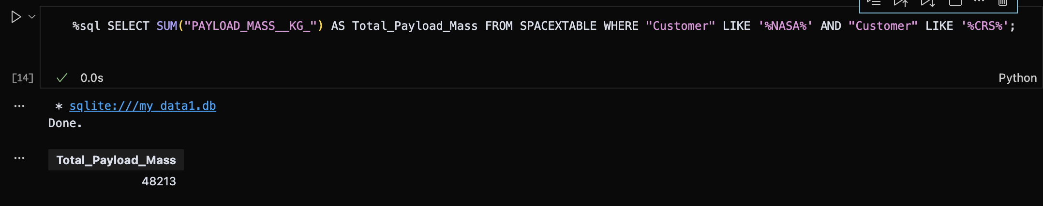
Total Payload Mass
Explanation:
Query:
SELECT SUM("PAYLOAD_MASS__KG_") AS Total_Payload_Mass FROM SPACEXTABLE WHERE "Customer" LIKE '%NASA%' AND "Customer" LIKE '%CRS%’;
This calculates the cumulative payload mass delivered to the International Space Station (ISS) by SpaceX on behalf of NASA through Commercial Resupply Services (CRS) missions.

Slide 27
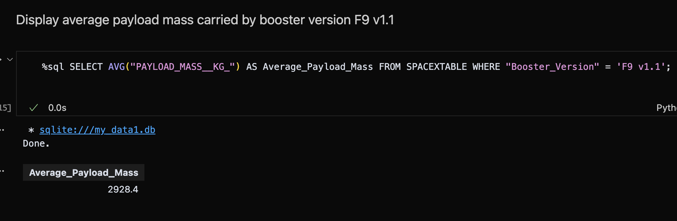
Average Payload Mass by F9 v1.1
Explanation:
Query:
SELECT AVG("PAYLOAD_MASS__KG_") AS Average_Payload_Mass FROM SPACEXTABLE WHERE "Booster_Version" = 'F9 v1.1’;
This calculates the average payload capacity for the F9 v1.1 booster version, indicating its typical carrying capacity for various mission types.

Slide 28
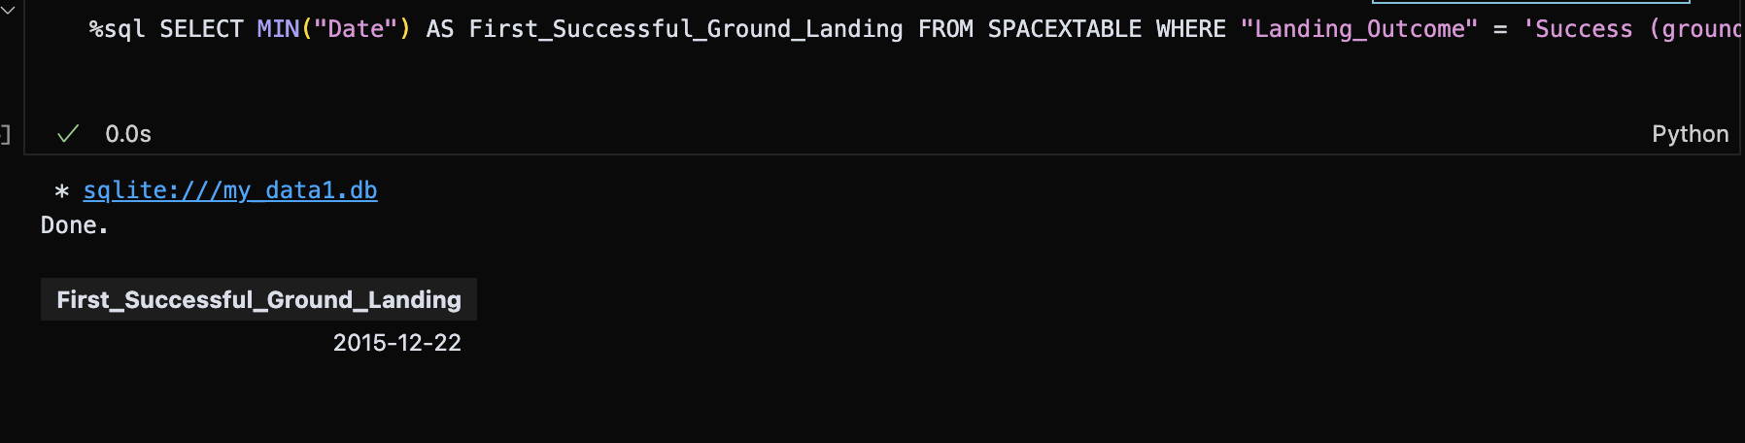
First Successful Ground Landing Date
Explanation:
Query:
SELECT MIN("Date") AS First_Successful_Ground_Landing FROM SPACEXTABLE WHERE "Landing_Outcome" = 'Success (ground pad)’;
This identifies the earliest recorded date when a SpaceX booster successfully landed on a ground pad, marking a significant milestone in reusability technology.

Slide 29
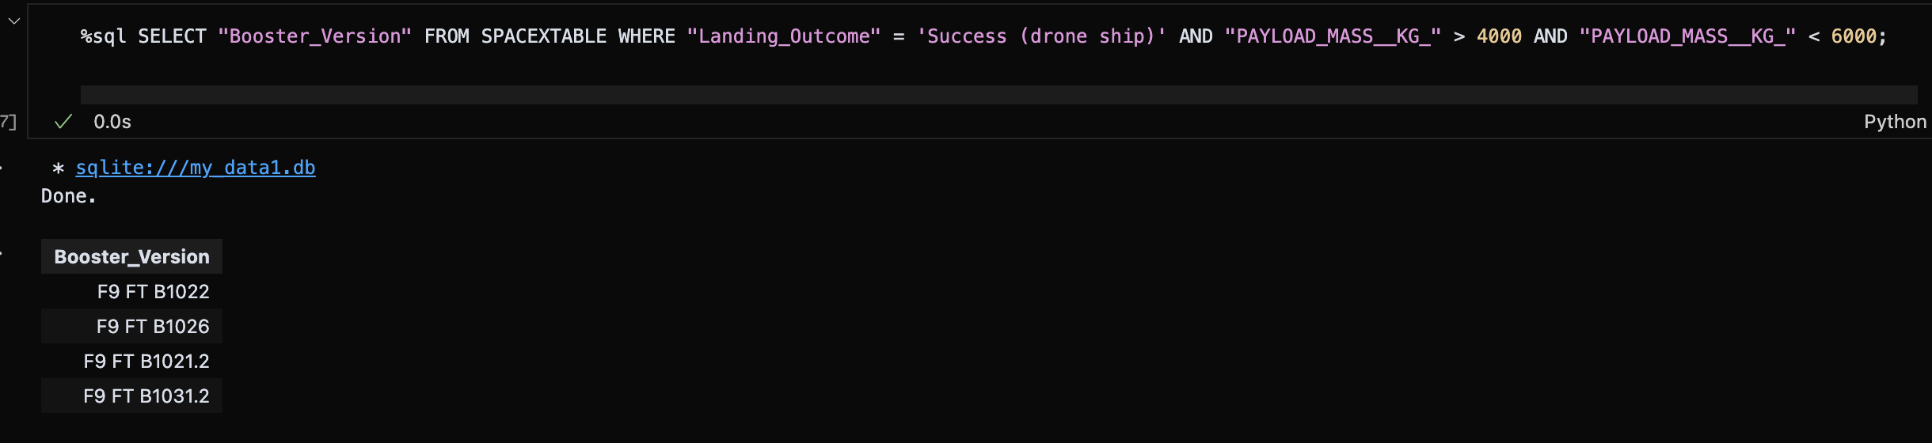
Successful Drone Ship Landing with Payload between 4000 and 6000
Explanation:
This identifies specific Falcon 9 boosters that successfully landed on drone ships while carrying payloads between 4000-6000 kg, demonstrating reusability within this payload range.

Slide 30
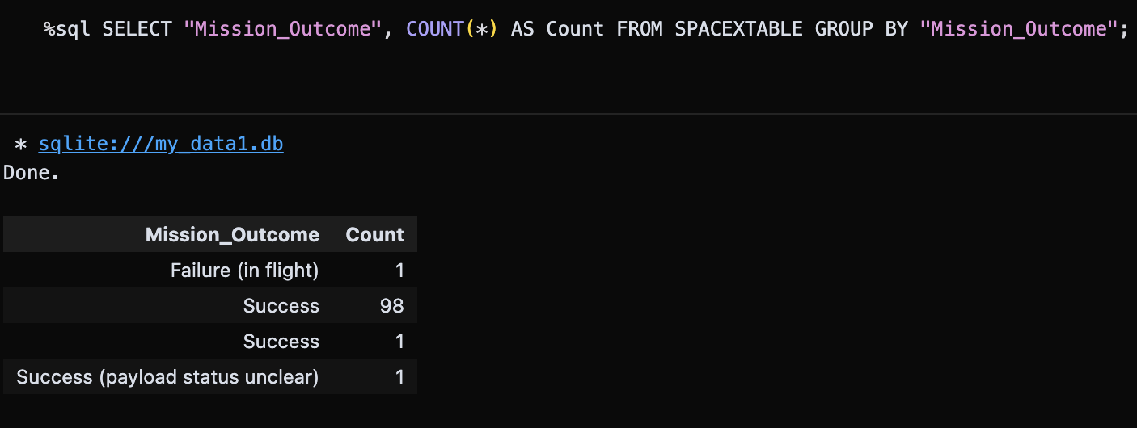
Total Number of Successful and Failure Mission Outcomes
This analysis shows SpaceX's mission outcomes with a 99% success rate. The data reveals two "Success" entries (98 + 1), indicating potential data categorization variations. The binary classification simplifies this to Success/Failure for machine learning.

Slide 31
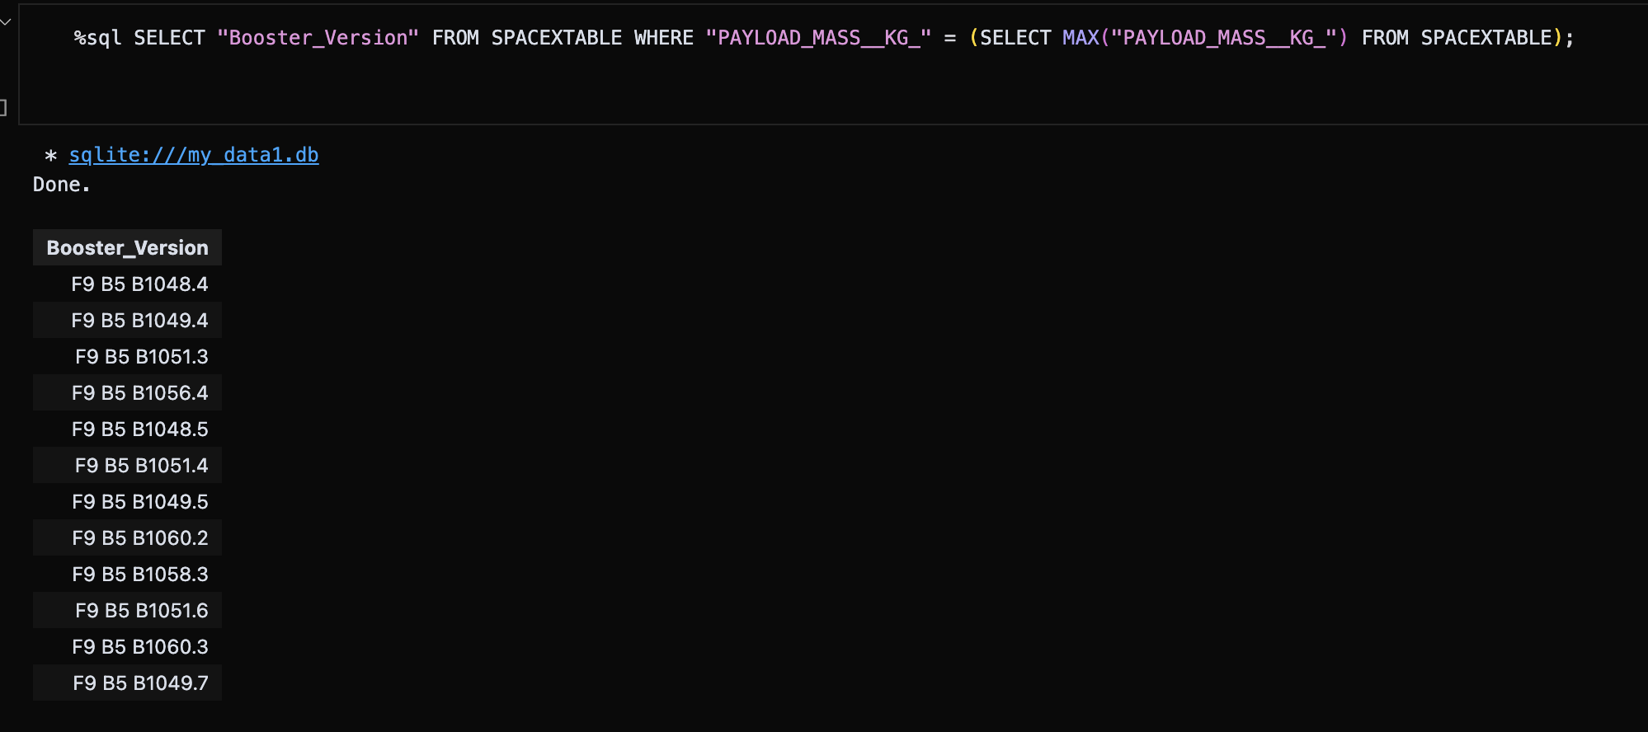
Boosters Carried Maximum Payload
This identifies all Falcon 9 B5 boosters that carried the maximum payload mass. The result shows 12 different booster serials, indicating multiple missions achieved the same maximum payload capacity, demonstrating the consistency of SpaceX's heavy-lift capability.

Slide 32
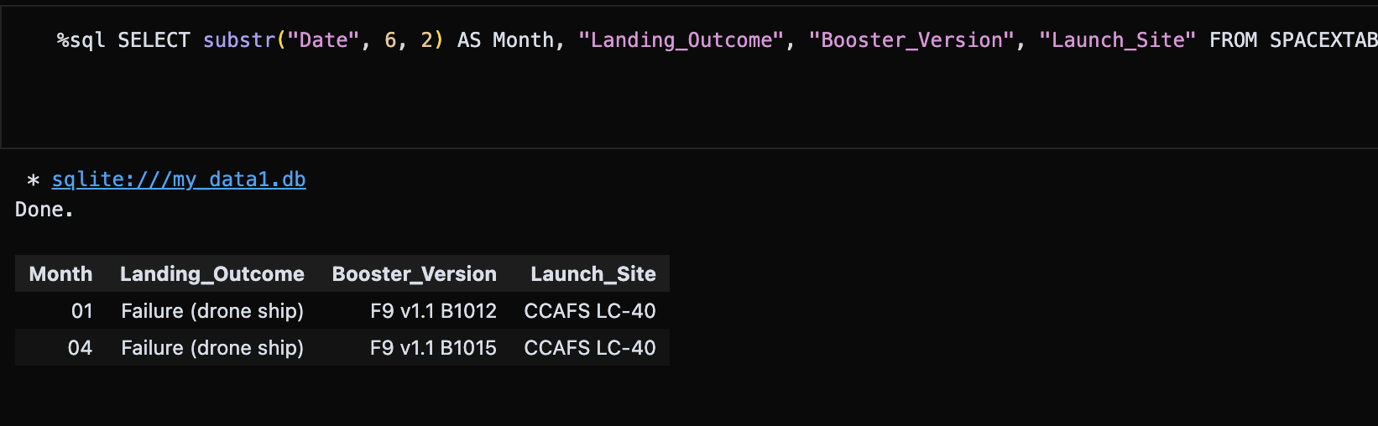
2015 Launch Records
This identifies all Falcon 9 B5 boosters that carried the maximum payload mass. The result shows 12 different booster serials, indicating multiple missions achieved the same maximum payload capacity, demonstrating the consistency of SpaceX's heavy-lift capability.

Slide 33
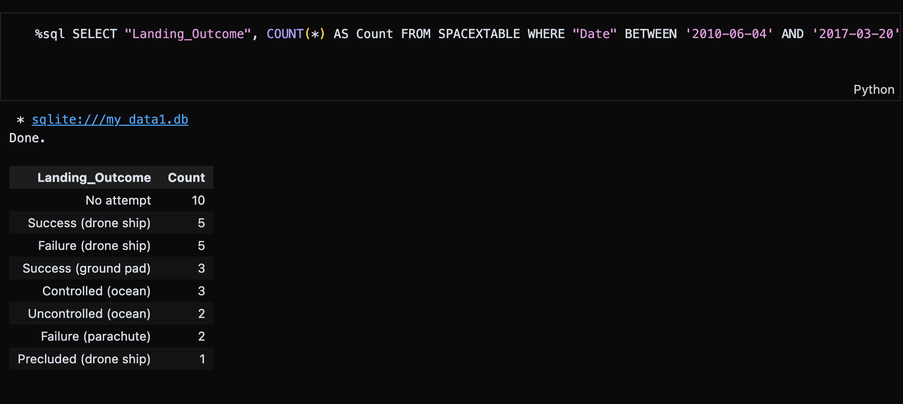
Rank Landing Outcomes Between 2010-06-04 and 2017-03-20
This analysis shows landing outcomes between 2010-2017, revealing that 10 missions had no landing attempts. Successful drone ship landings (5) equaled failed ones (5), indicating the challenging early development phase of SpaceX's reusable rocket technology.

Slide 34

Section 3

Slide 35
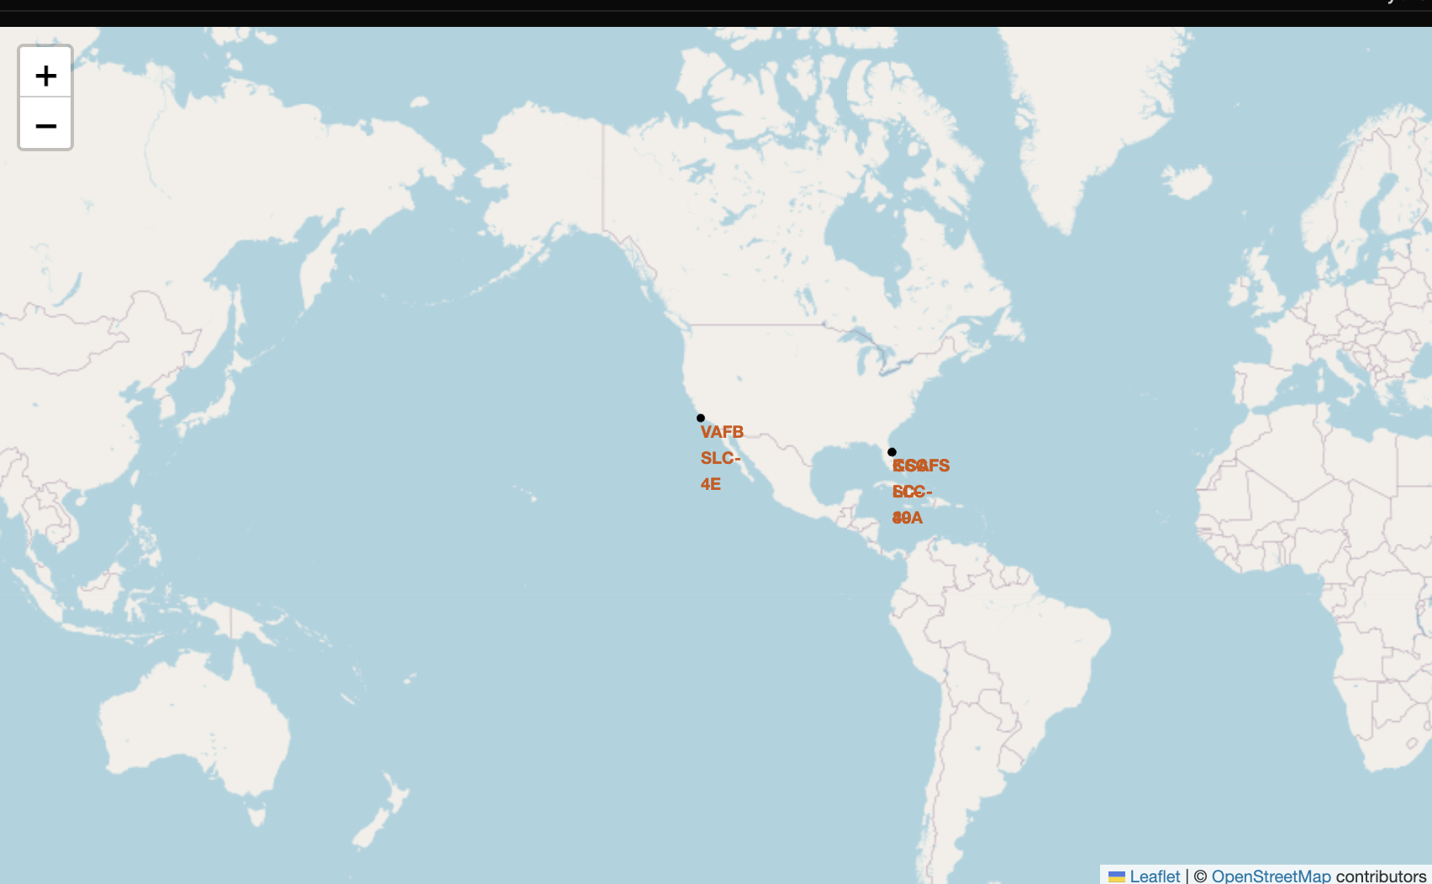
Global Launch Sites Map Analysis
Screenshot Analysis:
The map shows SpaceX's strategic launch site distribution across the United States:West Coast: VAFB SLC-4E (Vandenberg Air Force Base) - California
East Coast: KSAFS BCC-89A (Kennedy Space Center/Cape Canaveral) - Florida
Key Findings:
Geographic Coverage: Dual-coast launch capability enables diverse mission profiles
Orbital Access: East Coast sites support equatorial launches, West Coast supports polar orbits
Infrastructure: Established facilities at major spaceports
Operational Flexibility: Multiple launch sites reduce weather and scheduling constraints

Slide 36
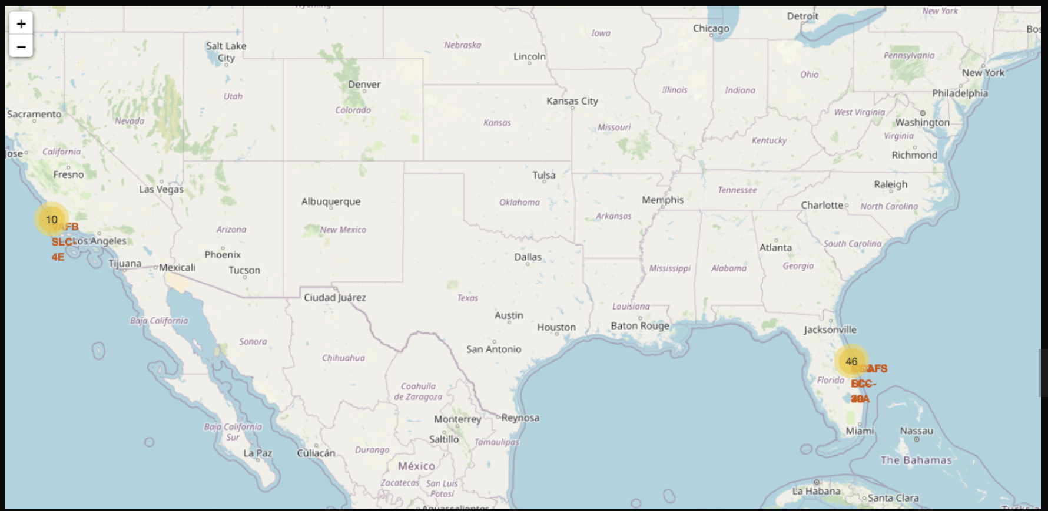
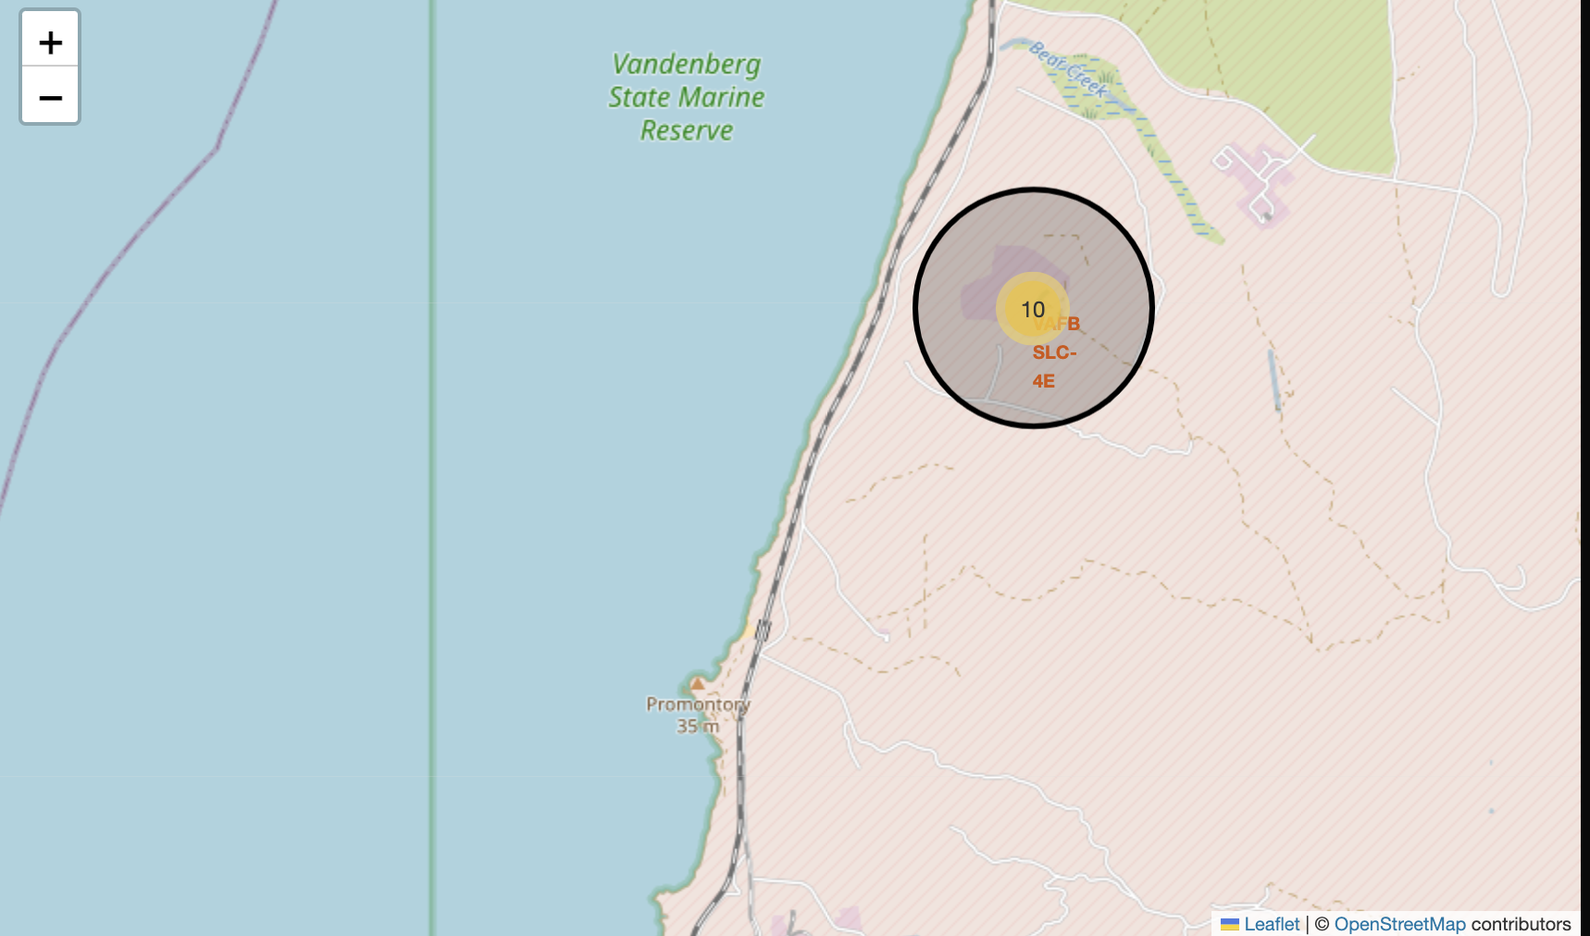
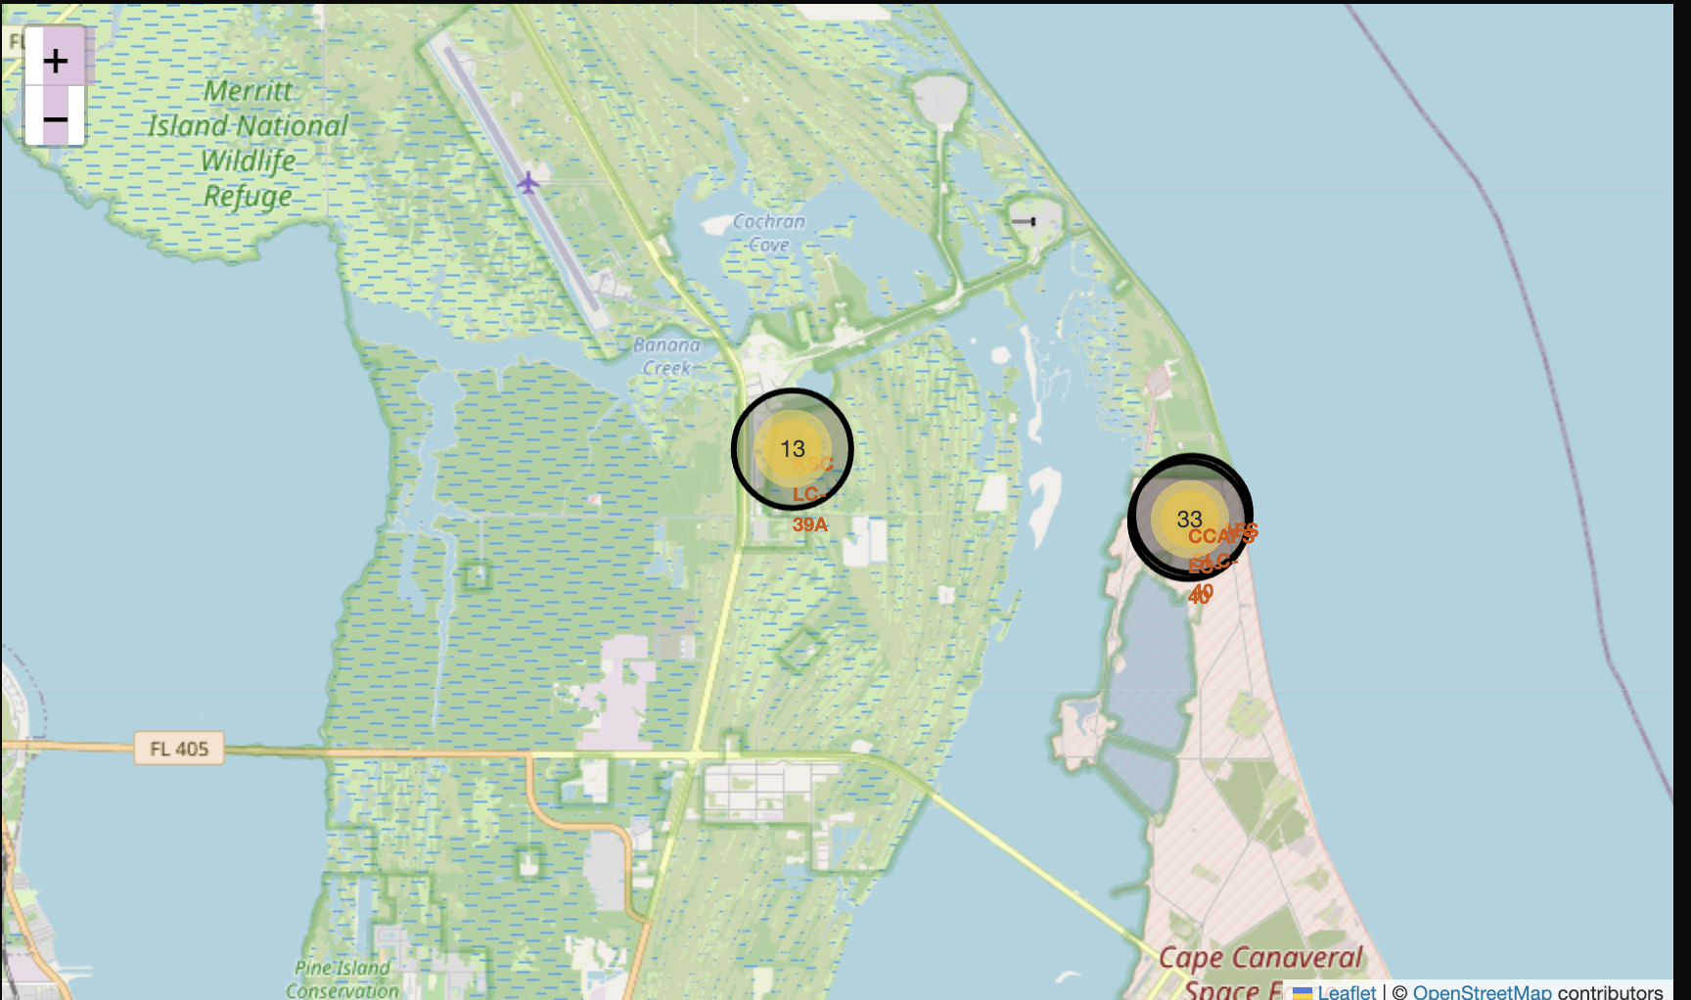
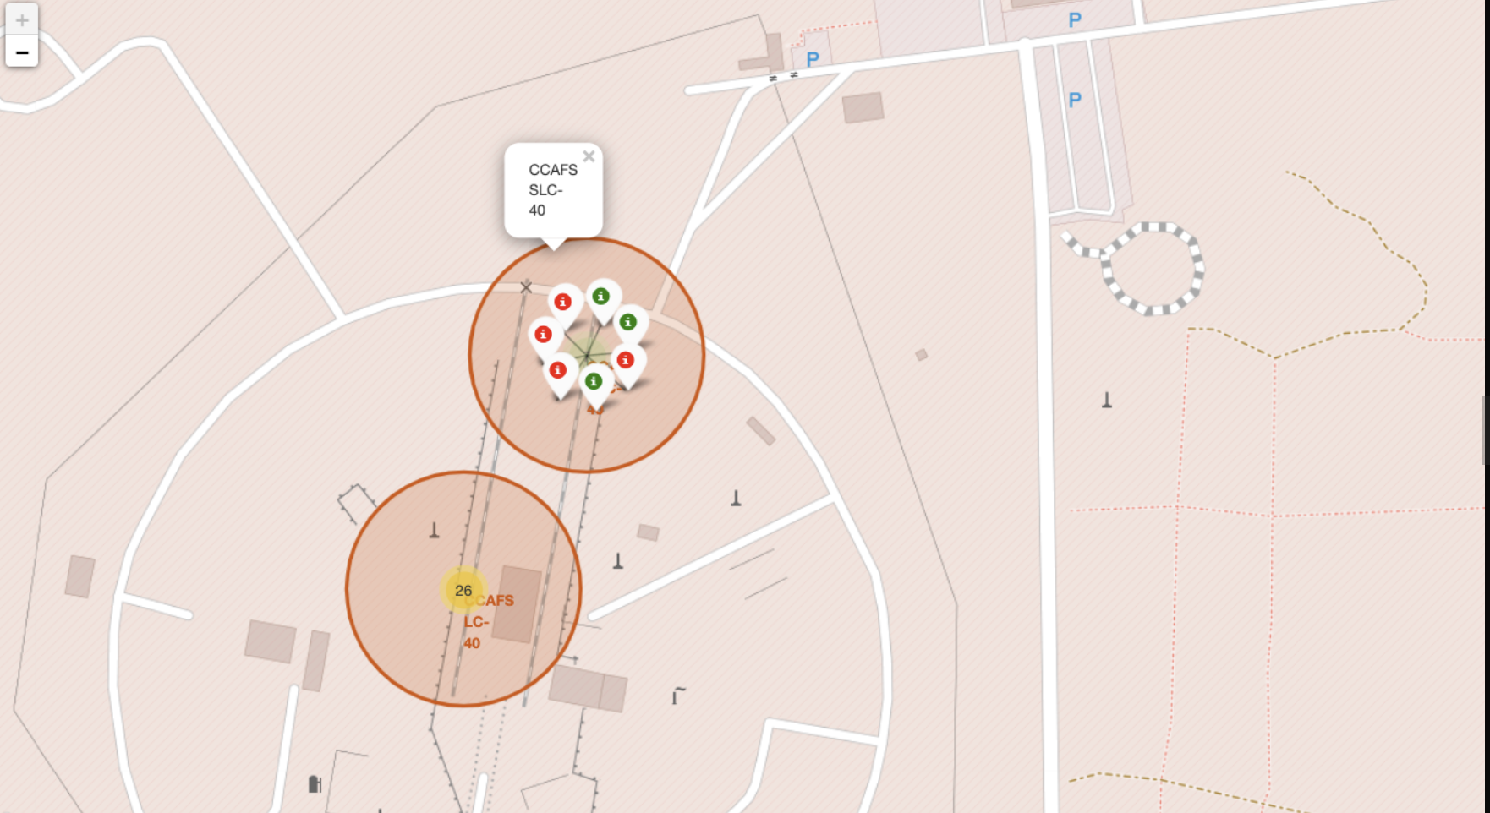
<Folium Map Screenshot 2>

Slide 37
Key Visualizations: West Coast (VAFB SLC-4E): 10 launches marked in California East Coast (KSC LC-39A): 46 launches in Florida Cape Canaveral Complex: 13 launches at LC-39A, 33 at CCAFS SLC-40 Clustered View: Success/failure patterns with color-coded markers Interactive Features: Multi-scale Views: From continental overview to detailed site analysis Color-coded Outcomes: Green (success) and red (failure) markers Launch Counts: Numerical indicators showing launch frequency per site Geographic Context: Proximity to coastlines and infrastructure Data Insights: Launch Distribution: Higher activity at East Coast facilities Success Patterns: Visual clustering shows landing outcome trends Site Utilization: Different launch frequencies across facilities Geographic Strategy: Strategic positioning for orbital access

Slide 38
<Folium Map Screenshot 3>
Replace <Folium map screenshot 3> title with an appropriate title
Explore the generated folium map and show the screenshot of a selected launch site to its proximities such as railway, highway, coastline, with distance calculated and displayed
Explain the important elements and findings on the screenshot

Slide 39

Section 4

Slide 40
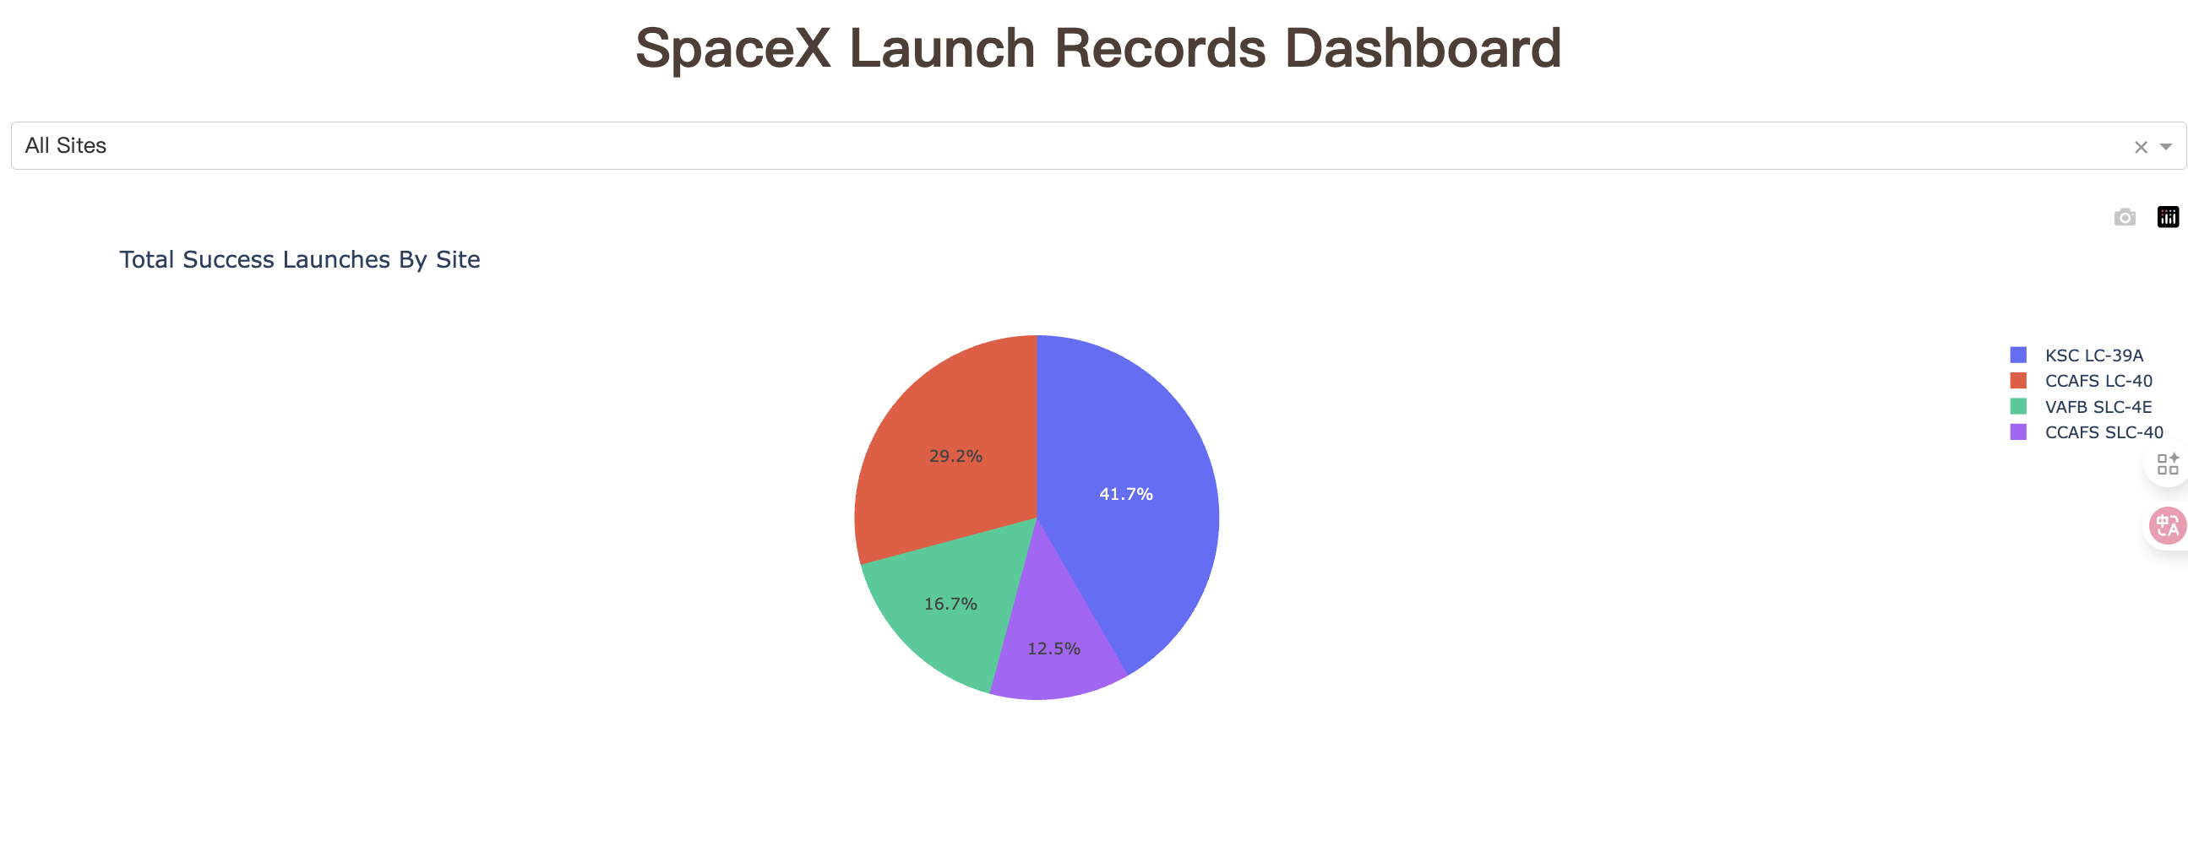
Pie chart (show the percentage of success launches)

Slide 41
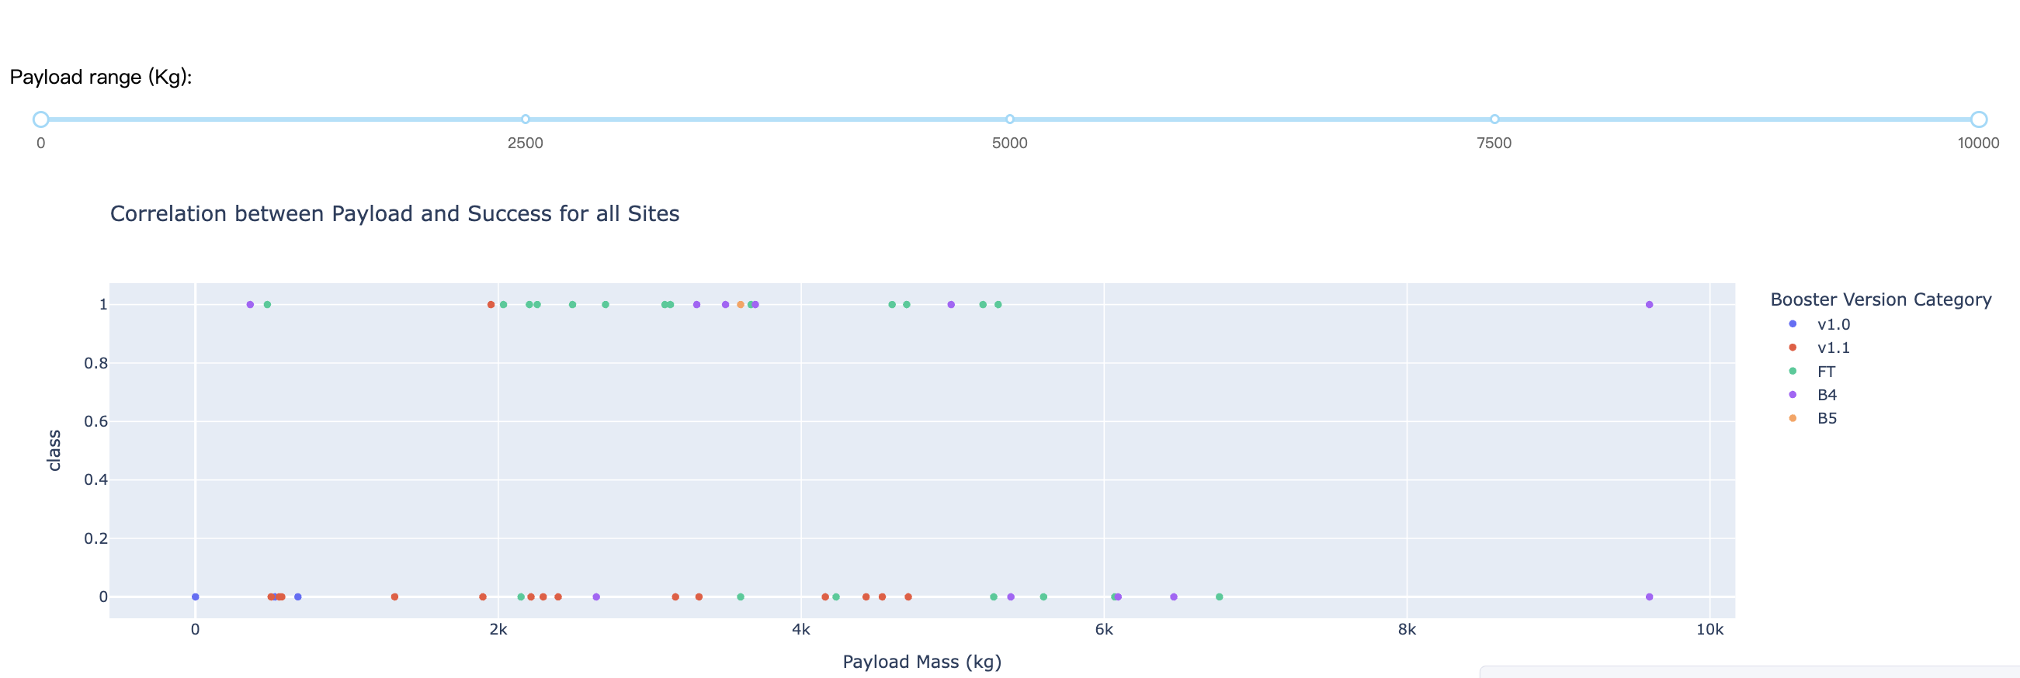
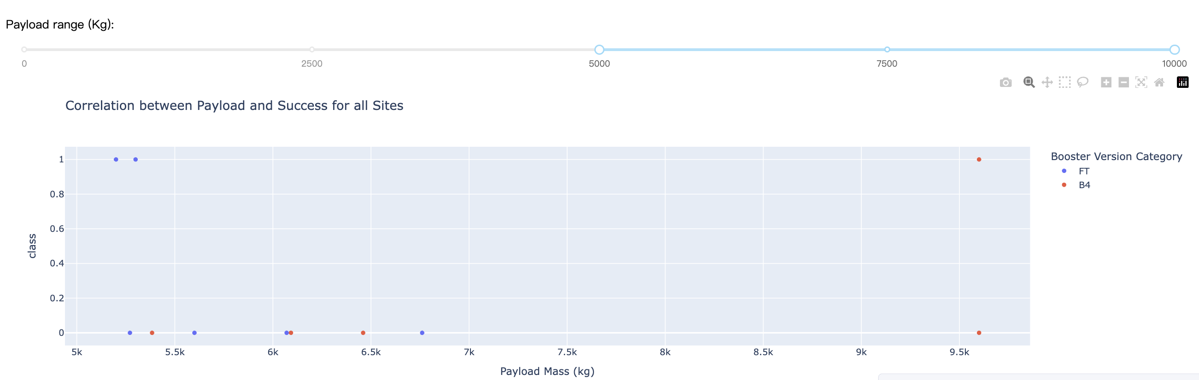
Scatter plot of Payload vs Launch Outcome for all sites with
Different weight

Slide 42

Section 5

Slide 43
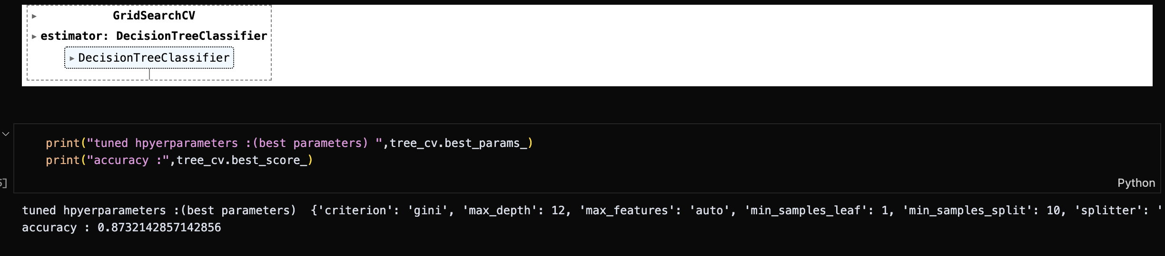
Classification Accuracy
Decision Tree achieved highest accuracy (87.3%) among four models tested. Logistic Regression(83.3%), SVM(84.8%), and KNN(83.3%). Decision Tree best predicts SpaceX landing success.

Slide 44
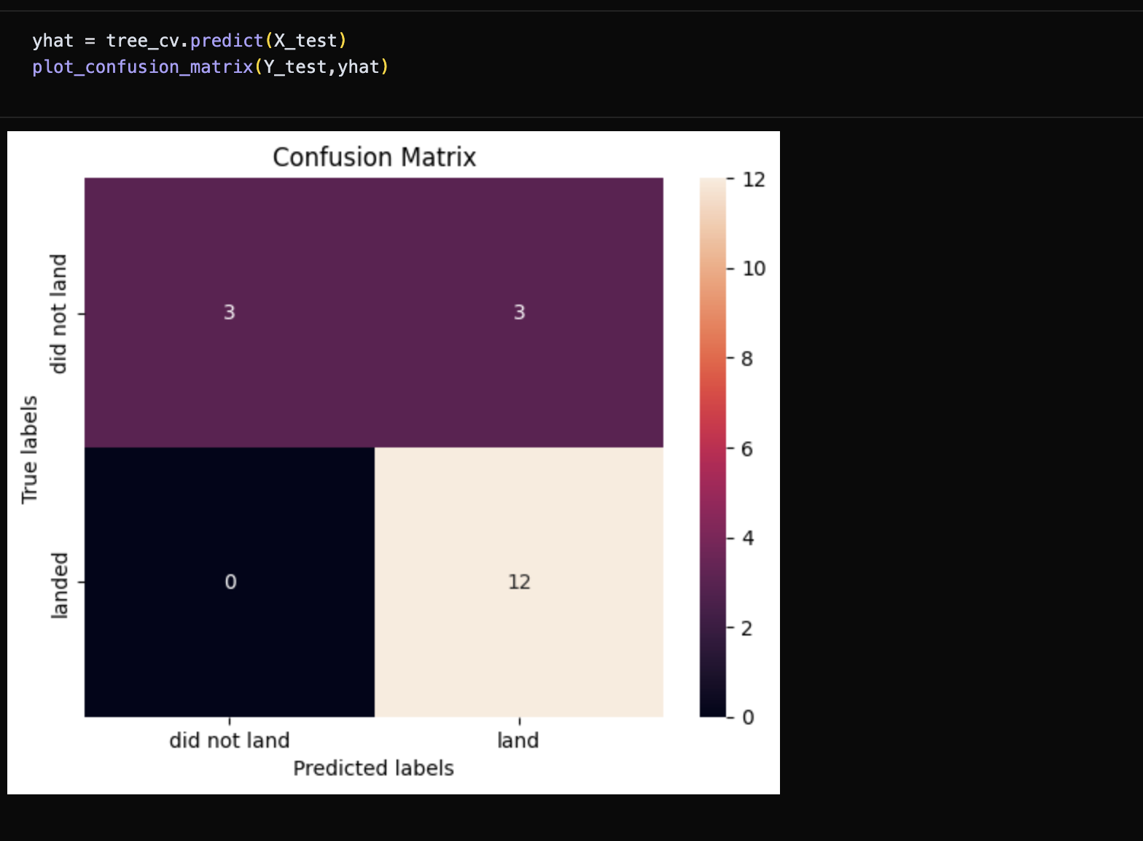
Confusion Matrix
Decision Tree model confusion matrix shows: 12 true positives (correctly predicted landings), 3 true negatives (correctly predicted failures), 3 false positives (incorrectly predicted landings), 0 false negatives (no missed landings). Model performs well with high precision.

Slide 45
Conclusions
Decision Tree achieved highest accuracy (87.3%) for SpaceX landing prediction
Launch site location and flight frequency impact landing success rates
Payload mass and orbit type significantly influence landing outcomes
Interactive dashboard enables real-time launch analysis
Machine learning successfully predicts Falcon 9 first stage landing success

Slide 46


